Slide 1
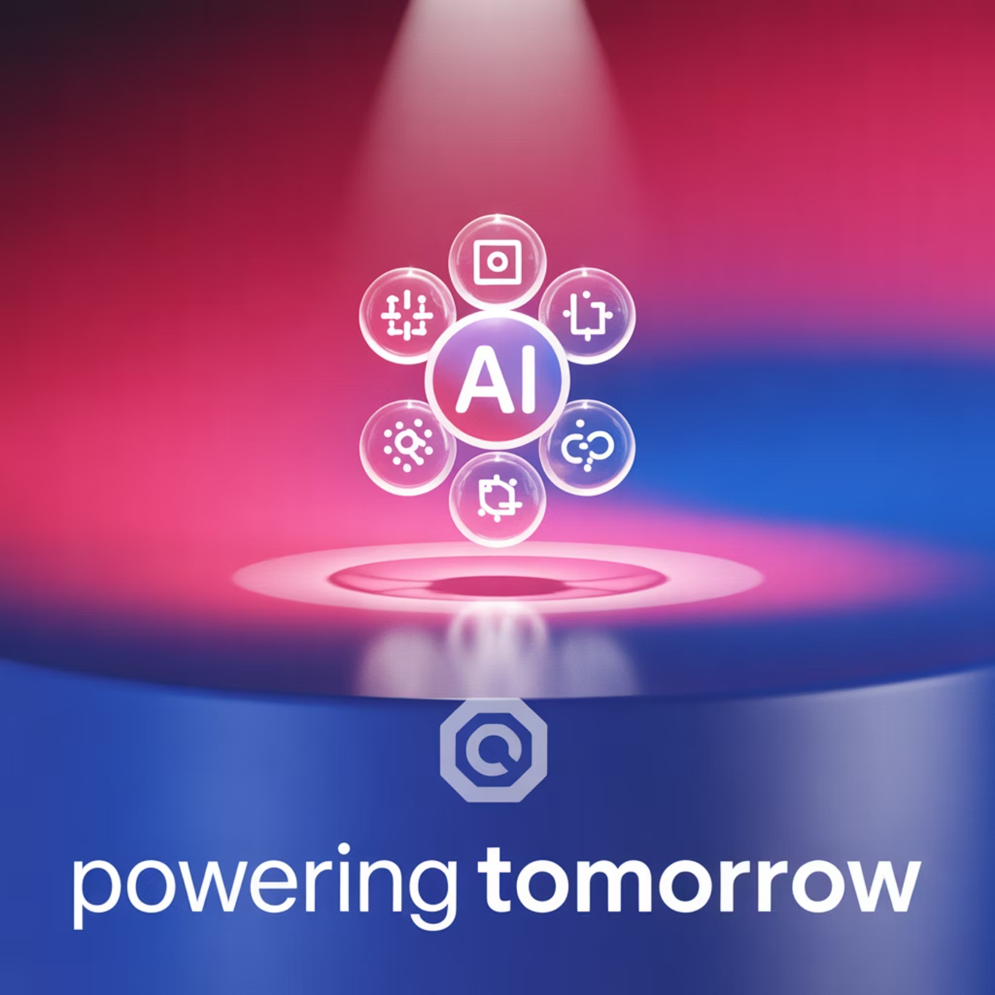
AI Applications Portfolio
Hashim Sayed Hoosini
Name:
Course:
ITAI 2372 – Artificial Intelligence Applications
Overview
Passionate AI student with hands-on experience in real-world deployments, open-source RAG tools, and ethical AI integration across industries.

Slide 2

Project Highlights
AI Applications
AI in Healthcare
CNN, NLP, and reinforcement Learning help in diagnostic, predictive care, and robotic surgery. As Michio Kaku explained, future AI will act as a personal health coach by using data to prevent illness before it starts.
AI in Agriculture
Computer vision, predictive analytics, and IoT+AI are enhancing efficiency, sustainability, and productivity. I learned how agricultural technology companies and farmers utilize AI-powered tools to monitor crops, predict outcomes, minimize waste, and automate processes.
AI in Space
Computer vision, machine learning, and autonomous navigation systems analyze satellite data, detect anomalies, and guide unmanned spacecraft to enhance safety and mission efficiency.
AI in Finance
Artificial intelligence enhances financial services by making systems smarter, faster, and more secure using ML, CNNs, and anomaly detection.
AI in Smart Cities & Transportation
AI is helping cities become smarter by improving transportation, reducing traffic, and increasing safety. AI is using real-time traffic management, smart public transit, and predictive maintenance of roads and vehicles.
AI in Entertainment and Media
AI is transforming the entertainment industry by creating smarter content, providing a personalized user experience, and automating production tasks. It utilizes Generative AI to generate art, voice, and video content, and make recommendations to users through a recommendation engine.

Slide 3

Project Highlights
Verba RAG Deployment
AI Applications
AI & Blockchain
Combining AI with blockchain can increase transparency, security, and automation across digital systems. I explored how AI enhances data analysis and decision-making, while blockchain ensures data integrity and decentralization control.
1
Installed and configured Verba using Docker,
Ollama, and Weaviate
2
Full document Q&A demo with LLM (LLAMA3)
AI in Retail
AI is transforming the retail industry by personalizing the shopping experience, enhancing inventory management, and improving customer satisfaction. Learned how stores and e-commerce platforms use AI to analyze customer behavior, make product suggestions, and automate checkouts and restocking.
AI in Government
AI is enhancing government services through tools such as chatbots for public support, data analytics for smarter policy decisions, and real-time surveillance systems that improve public safety. These technologies help agencies serve citizens faster, safer, and more efficiently.
AI in Manufacturing
AI is improving production through predictive maintenance, quality control systems, and robotic automation. These tools help manufacturers reduce downtime, detect defects early, and streamline operations, resulting in safer, faster, and more cost-efficient production.
AI & AGI
In this project, I learned the difference between AI and AGI. While AI is designed for specific tasks, such as recommendations or automation, AGI aims to perform any intellectual task like a human. I explored how the future AGI system could learn, reason, and adapt across domains- raising both exciting opportunities and ethical concerns.
Ethical & Societal Implications
In this project, I learned how AI raises critical ethical issues like bias, privacy, and job displacement. I explored the need for transparent, fair, and accountable AI systems and how ethics frameworks help guide responsible development to avoid harm and ensure public trust.

Slide 4
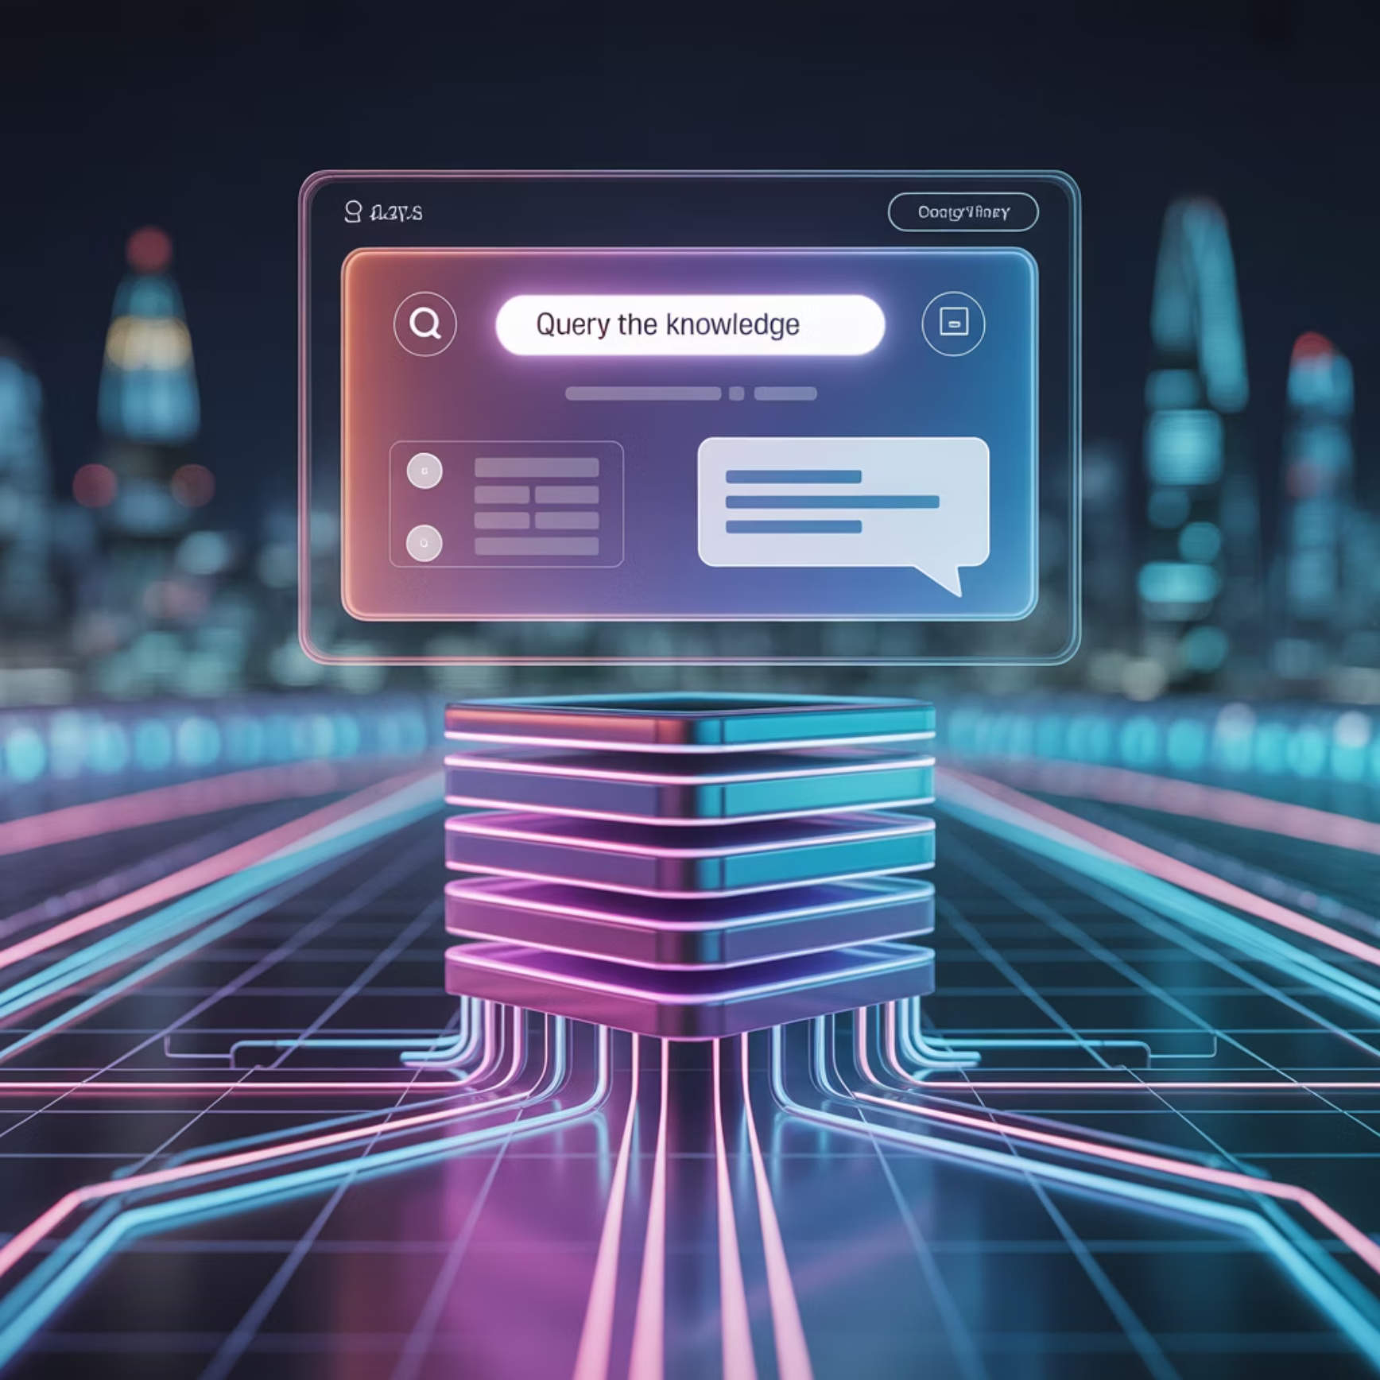
Tools & Concepts Mastered
Technical Tools
AI Concepts
Other Skills
Docker
Chunking
GitHub repo setup
Python
Tokenization
Familiar with global AI Ethics frameworks
FastAPI
Vectorization
Git
Embedding
Ollama
Retrieval
Weaviate
Generation
LLAMA3

Slide 5












Real-World Applications
Learned domains
Problems Solved
Healthcare
Space Exploration
RAG- installation
Document uploads
Finance
Retail / E-commerce
Chatbot query
Ethical AI tools
Agriculture
Transportation
Government
Unique Edge
Entertainment
Hands-on full-stack deployment
Manufacturing
Blockchain and Digital Innovation
General AI & Artificial General Intelligence (AGI)
Ethical and Societal Implications of AI

Slide 6

Wrap-up
https://github.com/sayedHoosini/AI_Portfolio_ITAI2372
GitHub Repository
Contact:
Phone: +1 832-228-3528 Email: Babak201070@gmail.com

